Slide 1

Self Play

Slide 2
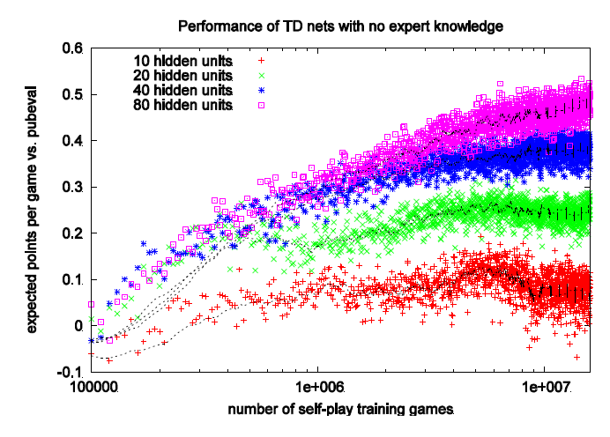
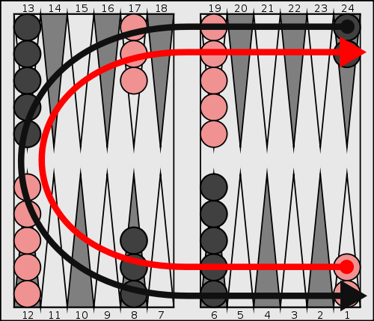
Self Play: TD-Gammon
TD-Gammon (Tesauro, 1992)
Incredibly old work:
  Q-learning + neural networks + self play
  Beat all humans, discovered unconventional strategies that were deemed to be better!
Approach was dormant until DQN for Atari

Slide 3
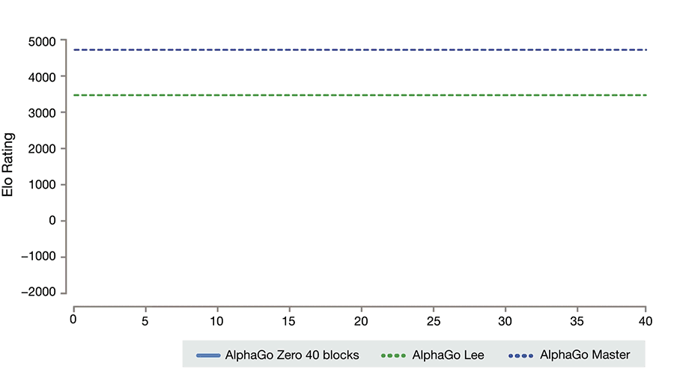
Self Play: AlphaGo Zero

Slide 4
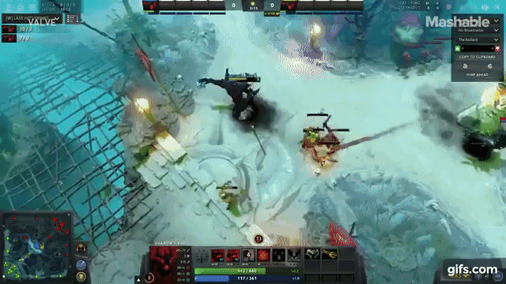
Self Play: Dota 2
Pure self play
Popular competitive online e-sports game
  Serious professional scene: $140M awarded in prizes in 2016
  5v5 is main variant; 1v1 also played
OpenAI beat all pros at 1v1

Slide 5
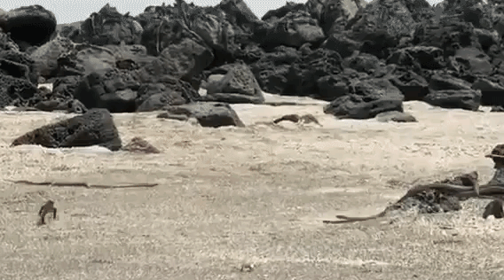
Self Play: The promise
Simple environment → extremely complex strategy
Convert compute into data
Perfect curriculum

Slide 6
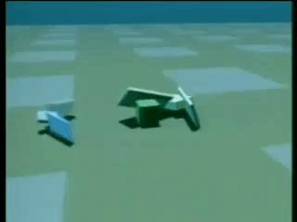
Self Play: Artificial life
Carl Sims, 1994

Slide 7
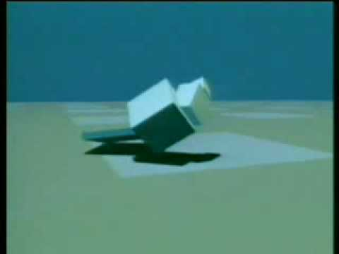
Self Play: Artificial life
Carl Sims, 1994

Slide 8
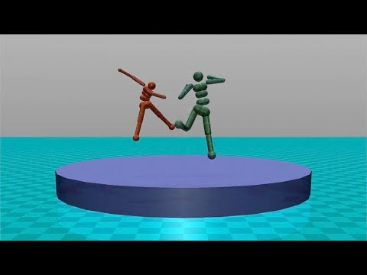
Self play for physicality and dexterity
Environment is simple, behavior is very complex
Pre-train “general dexterity” by competing against an opponent

Slide 9
Self Play: the future
Key open question: design the self play environment so that the result will be useful to some external task

Slide 10
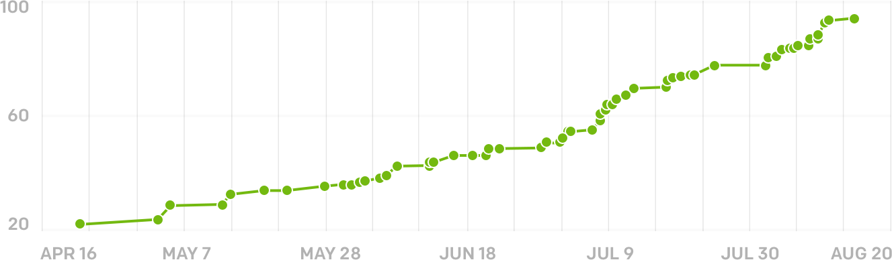
Self Play: rapid increase in competence
Dota 2 1v1: 5 months of scaling and bug fixes
Very rapid increase in performance
More compute = more and better data
Top allrounder
Top 1v1
Scripted bot
Amateur
Semi-pro
Top 50

Slide 11
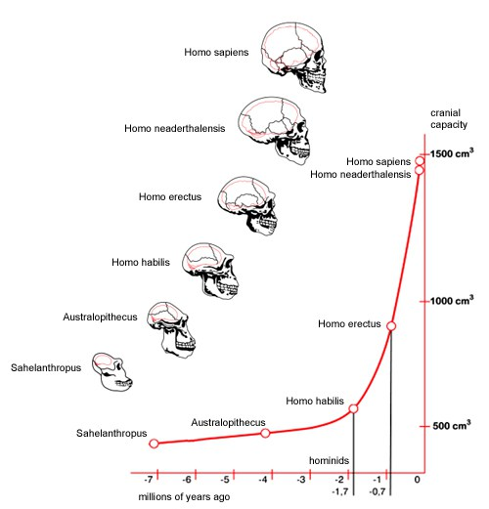
Hypothesis: AGI will be trained via self play
Social life incentivizes evolution of intelligence
  “Because corvids and apes share these cognitive tools, we argue that complex cognitive abilities evolved multiple times in distantly related species with vastly different brain structures in order to solve similar socioecological problems.” — Science, Vol. 306, Issue 5703, pp. 1903-1907
Open-ended self play produces:
  Theory of mind, negotiation, social skills, empathy, real language understanding
Alignment issues
  Agents will learn aggression

Slide 12
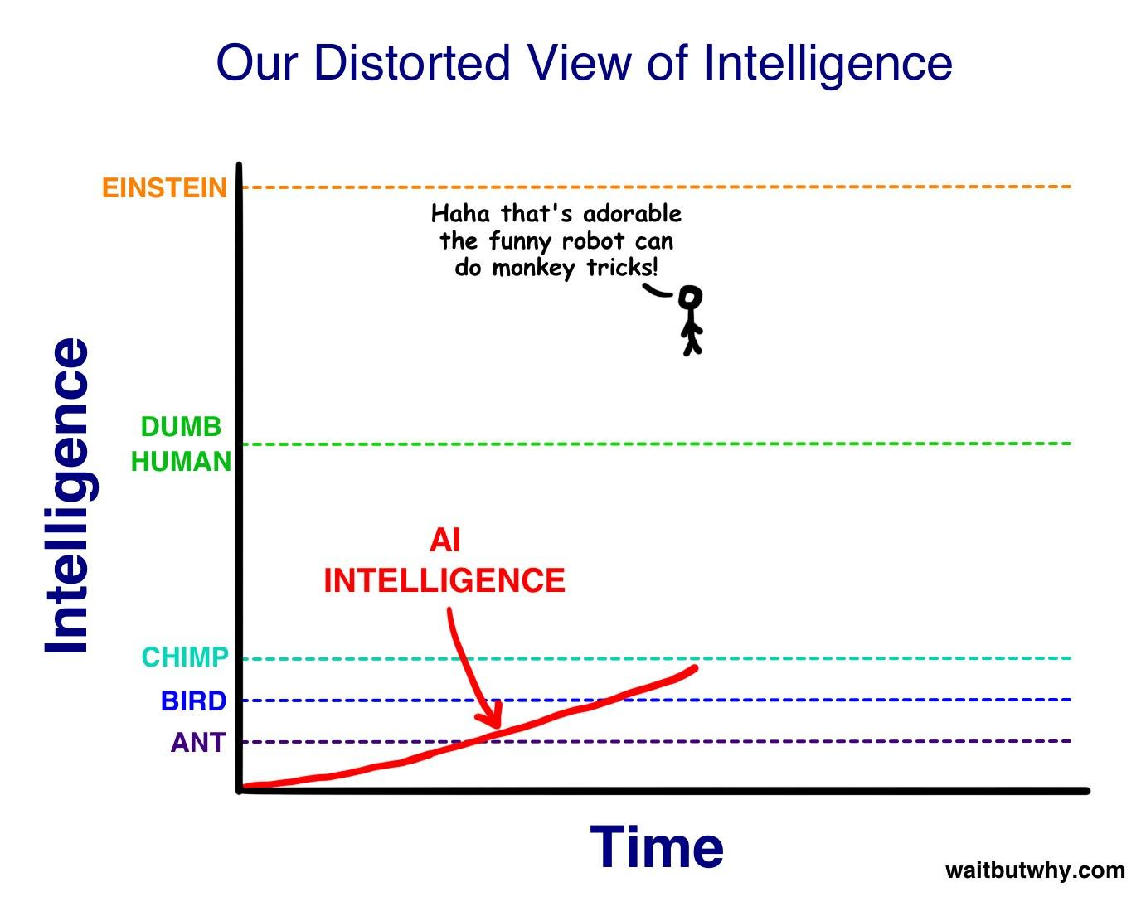
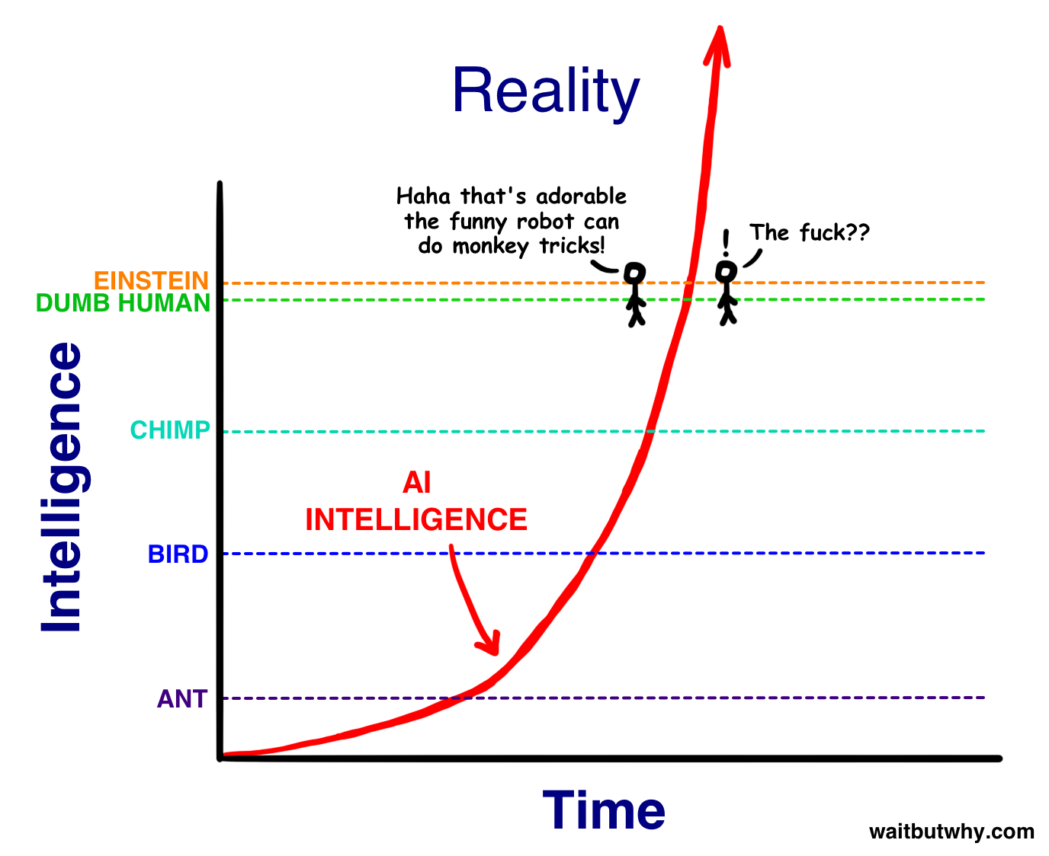
Prediction: AGI will rapidly increase in competence

Slide 13
Thank you!

