Slide 1
PathNet and Beyond
Chrisantha Fernando, Dylan Banarse, Vikram Tankasali

Slide 2
Part 1: Evolution alone

Slide 3
Evolved CTRNN controllers

Slide 4
Cheetah (10 Node CTRNN Controller with Logistic Readouts)

Slide 5
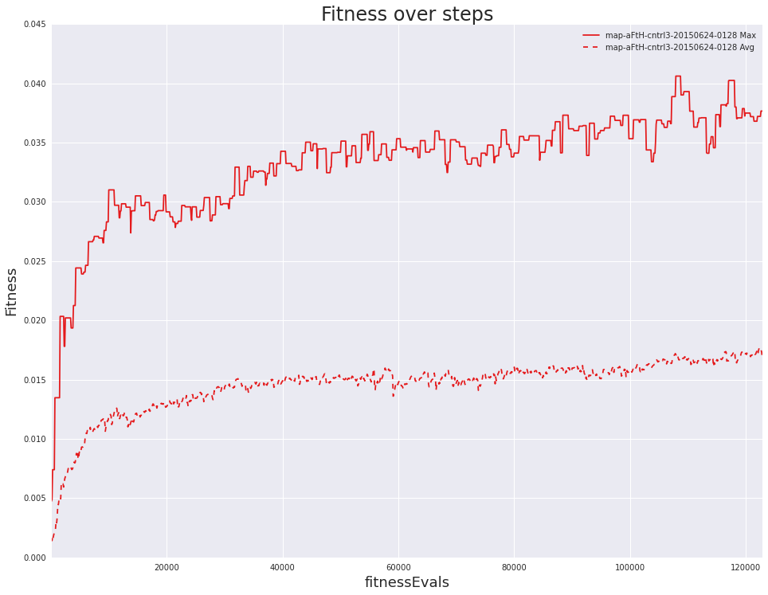
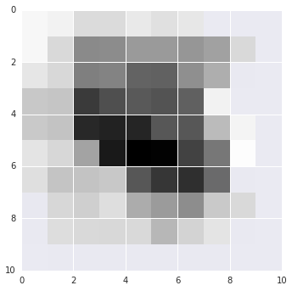
170k evals
Cheetah
← Low Torso Height High →
← High Absolute Forces Low →
game CheetahCTRNN experiment map-aFtH-cntrl3-20150624-0128 Xover 0.1 ctUpdates 100 ctXover 0.2 ctOuts 6 ctSize 12 features 34 borgCell jc user dylski fitMeasure SumVelocity TargVel NaN TargVelSensitivity NaN TargVelMin NaN TargVelMax NaN mapEliteSize 10 mapEliteFeature1 absForce mapEliteFeature2 torsoHeight

Slide 6
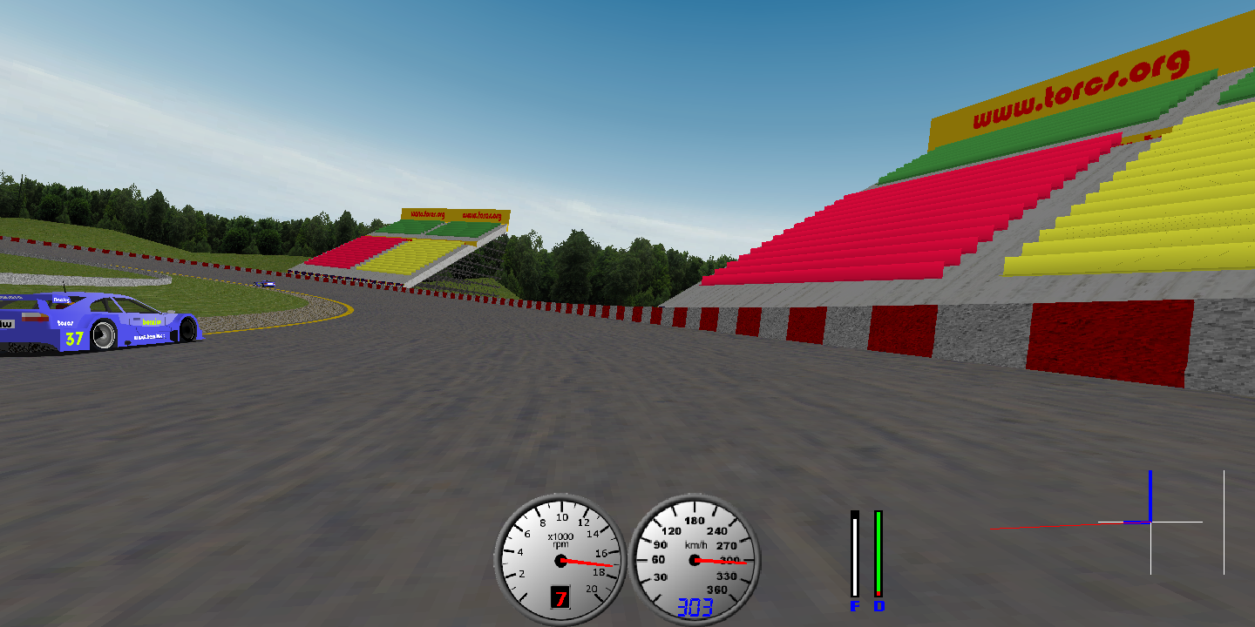
R/G/B/S
kernel size
sigma
angle
period
ellipse ratio
S R R
R R B
13 x 13
filters
evolved
S B R
S S B
Logistic unit weights and biases
0.1835
-0.2432
[torch.DoubleTensor of dimension 2]
Columns 1 to 8
0.6756 -0.3229 0.0373 1.5465 -2.5750 0.6503 -5.1691 -3.6398
0.0528 0.0283 0.7607 23.8260 -1.4457 1.4905 1.2480 1.8071
Columns 9 to 13
-0.0645 -0.5631 1.3669 0.2337 -0.1089
-0.5518 -0.0072 0.0116 0.2547 0.0416
[torch.DoubleTensor of dimension 2x13]
car position - scalar distance travelled along length of track from start line (metres)
car angle - heading of car with respect to current track segment (radian?)
track angle at current position - don't know, what does this measure?
car distance from middle of track - Offset from centre of track (+/- metres)
car distance from left edge of track - derived from above?
car distance from right edge of track - derived from above?
car velocity - speed of car along it's longitudinal axis, i.e. +ve even if driving towards barrier or wrong way around track
car distance raced (in total, not just current lap) - metres
car fuel capacity - max fuel possible(?) (litres)
car fuel left - decreases to zero (litres)
car damage - increases to 'max damage' at which point car is disqualified - should be include 'max damage'?
Bee Vision System
12
0.1835
2 Logistic Units (Steering, Accel/Break)
12

Slide 7
Bee vision + 12 features

Slide 8
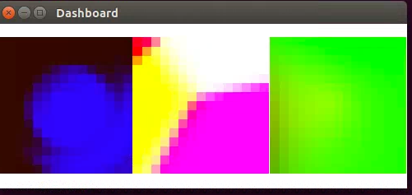
nn.SpatialConvolution(3, 3, 15, 15)
model:add(tanh)
nn.SpatialAveragePooling(20, 20, 20, 20)
nn.Linear(3*3*7, 12)
add(nn.Tanh())
12 neurons
7 neurons
7 integer actions
Evolved CPPN encoded convolutional kernels and weights of a small FFNN

Slide 9
Part 2: Evolution vs. Gradient Descent + Backprop

Slide 10
Evolution vs Gradient Descent/Backprop
Supervised Learning Tasks:
Gradient descent learning with backpropogation can train millions of parameters, e.g. > 60M for imageNet.
Morse and Ken Stanley’s Limited Evaluation EA: 1,470 parameters ~ similar performance to SGD
Reinforcement Learning Tasks:
Unreal: RL with auxiliary supervised learning tasks used several million parameters (for training), achieved results better than A3C on Atari, Labyrinth etc…
OpenAI: Used an ES to train a model with ~700,000 parameters, and achieved similar results to DQN, worse than A3C (more training/random not human restarts)
Fourier representations (Koutnik, 2013) 1M weights, and HyperNeat (1M/8M) weights.
Josh Bongard’s evolutionary robotics work and NEAT < 1000 parameters
Optimization Tasks:
Breaking the Billion-Variable Barrier in Real-World Optimization: (Deb) if a good recombination operator is hand-designed to exploit problem structure, the algorithm can scale.

Slide 11
Part 3: Evolution + Gradient Descent

Slide 12
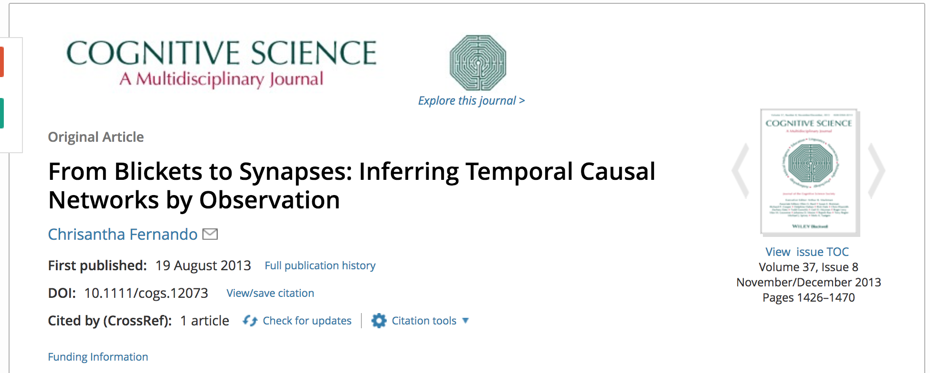
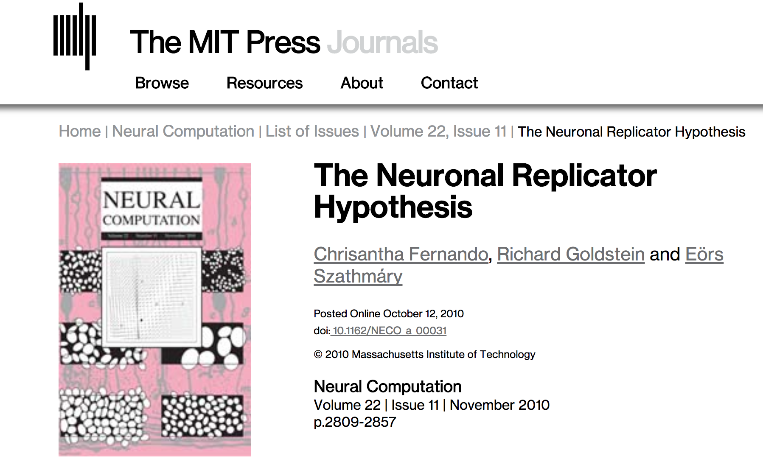
Evolution in the brain?

Slide 13
PathNet

Slide 14
Currently we train our own separate neural networks
Dylan

Slide 15
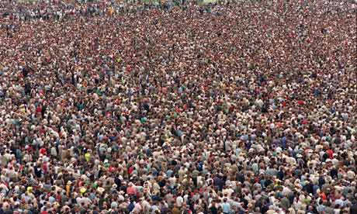
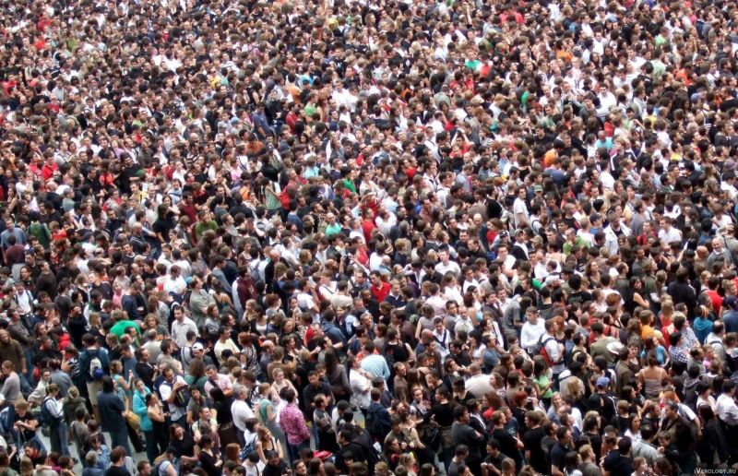
Can we all train the same neural network?

Slide 16
General a2c Architecture
Source Game
INPUT
丌
V
Torso
Heads
Target Game
丌
V
Layer 1
Conv2D
Layer 2
Conv2D
Layer 3
Conv2D
Layer 4
Linear
Notes:
The a2c torso has been modularised to enable pathNet to be implemented
Each layer contains a number of single-layer networks that feed into a reduce sum.

Slide 17
a2c Torso is Modularised for pathNet
Conv
Skip
Source Game
Linear
INPUT
丌
Residual
V
Etc
ReduceSum module
ReduceSum module
ReduceSum module
ReduceSum module
Target Game
丌
Conv2D Modules
Conv2D Modules
Conv2D Modules
Linear Modules
V
Layer 1
Layer 2
Layer 3
Layer 4
Conv2D Modules
ReduceSum modules
Linear layer modules
Notes:
The a2c torso has been modularised to enable pathNet to be implemented
Each layer contains a number of single-layer networks that feed into a reduce sum.

Slide 18
A Genotype Specifies a Subset of Modules To Use
0
1
Source Game
2
丌
3
V
4
5
6
Target Game
7
丌
8
9
V
[1, 4, 5, 8], [2, 3, 5, 9], [1, 2, 2, 2], [2, 4, 4, 7] = Genotype
Conv2D Modules
ReduceSum modules
Linear layer modules
Active modules
Notes:
A genome specifies which modules on each layer are active

Slide 19
Genotype is a pathway (DAG) Through Large Network
Source Game
INPUT
丌
V
Target Game
丌
V
Conv2D Modules
ReduceSum modules
Linear layer modules
Active modules
Notes:
Thus, a genome specifies a directed acyclic graph through the modularised torso (large network)

Slide 20
Each Genotype is a Different Policy and Value Fn
Source Game
INPUT
丌
V
Target Game
丌
V
Conv2D Modules
ReduceSum modules
Linear layer modules
Active modules
Notes:
Forward pass determines policy and value fn

Slide 21
Gradients Only Pass Through Genotype’s Modules
Source Game
INPUT
丌
V
Target Game
丌
V
Conv2D Modules
ReduceSum modules
Linear layer modules
Active modules
Notes:
Backward pass through DAG modules used to pass gradients for training

Slide 22
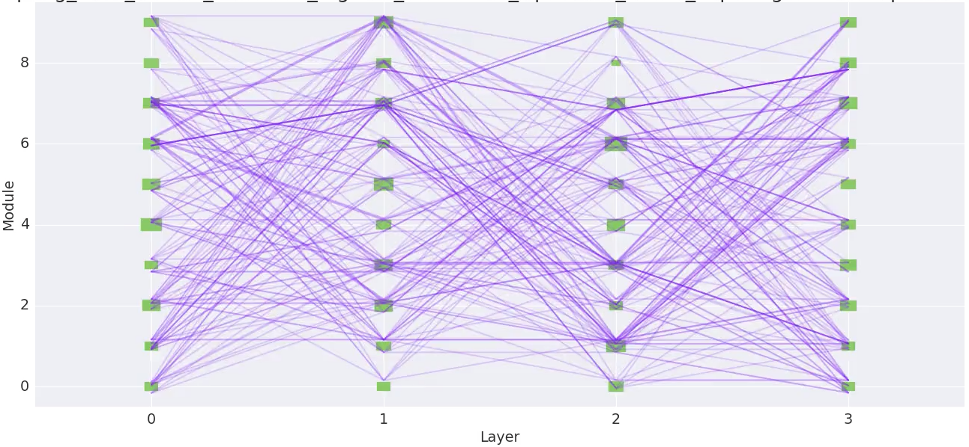
Population Initialised with 64 Overlapping Paths
Source Game
丌
V
Target Game
丌
V
Line weight represents paths that overlap (Reduce_sum modules omitted)
Conv2D Modules
ReduceSum modules
Linear layer modules
Active modules

Slide 23
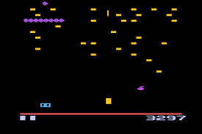
Workers Train Using Only Their Genotype’s Pathway
Worker 1
Shared parameters
Genotype Fitness
New
Genotype
Genotypes
& Fitnesses
Synced
Parameters
Worker N

Slide 24
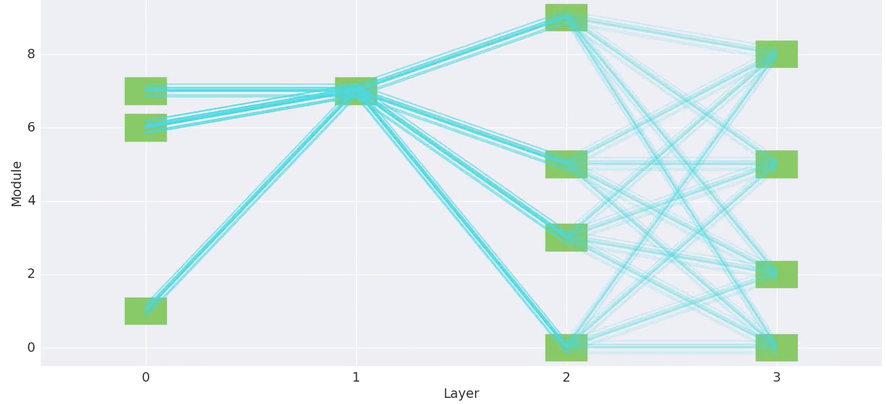
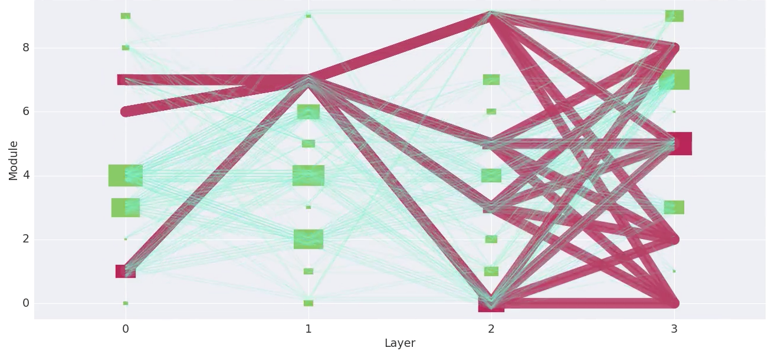
Transfer/Continual Learning Setup
For each game in sequence [pong, alien, etc]:
(Re)initialise population of 64 genotype paths
Train all genotype paths on current game
Pathways should converge (depending on mutation rate, selection pressure)
Freeze best path on this task (but still allow back-propagation of gradients, and forward pass)

Slide 25
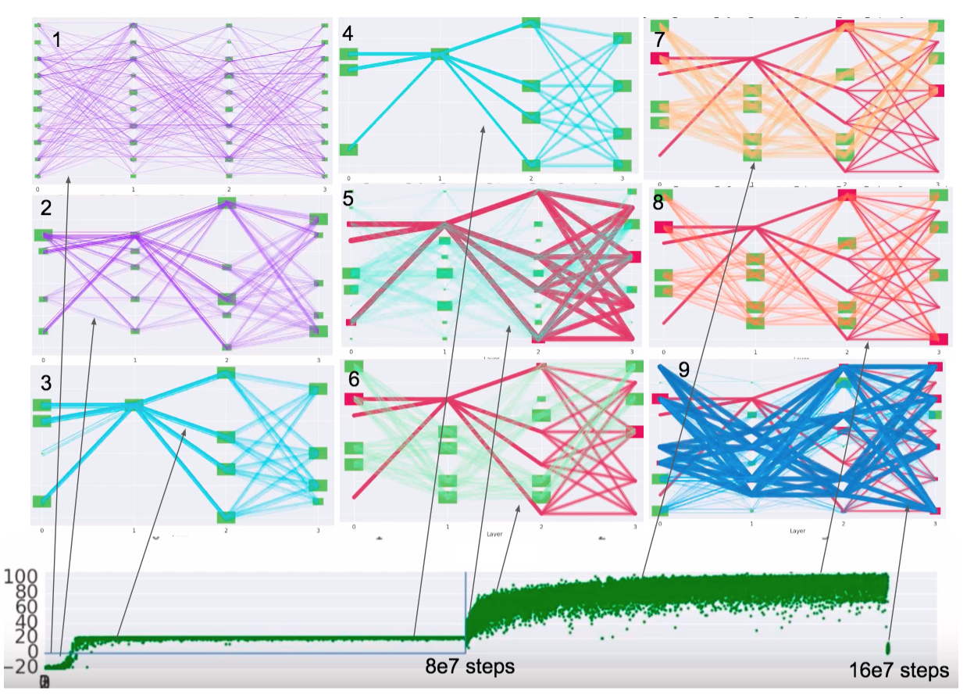
Stages of Path Evolution

Slide 26
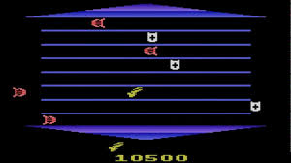
Evolve paths on source task, fix optimal path weights, reset other weights, evolve new paths on target task.
Source Task
Source
丌
V
Target Task
Conv 2D (8)
Conv 2D (8)
Conv 2D (8)
Linear (50)
丌
V
Target
GameN
丌
V

Slide 27
PathNet on Atari
PathNet is better than learning from scratch and fine-tuning controls for transfer learning.

Slide 28
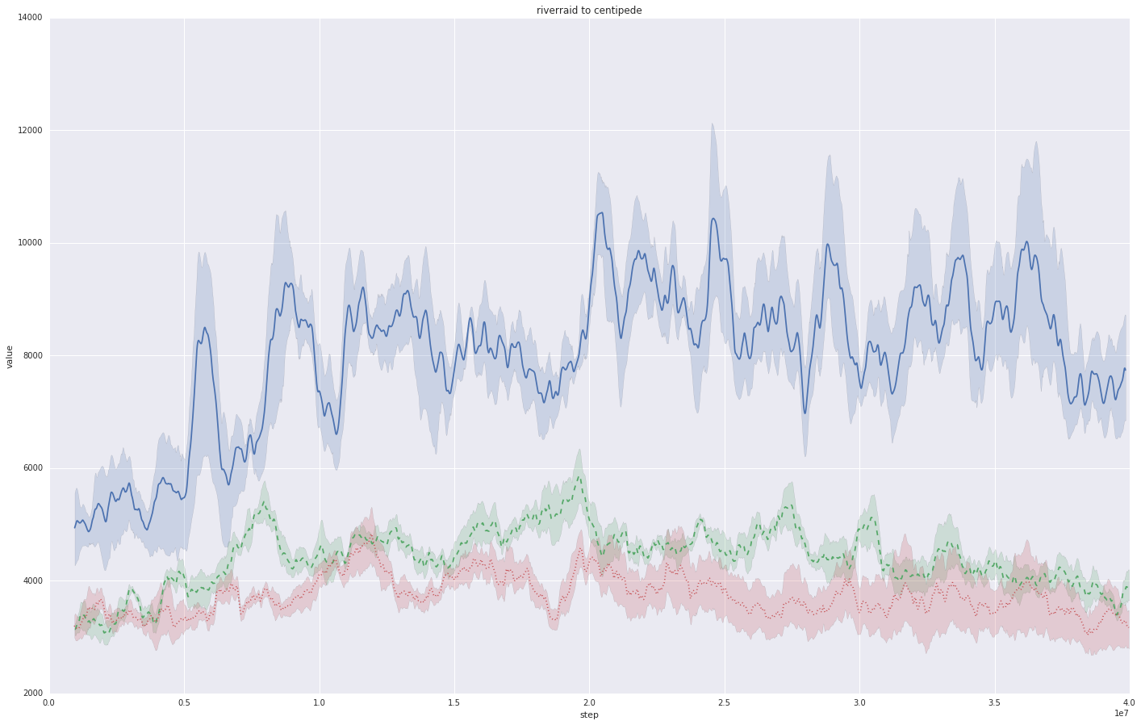
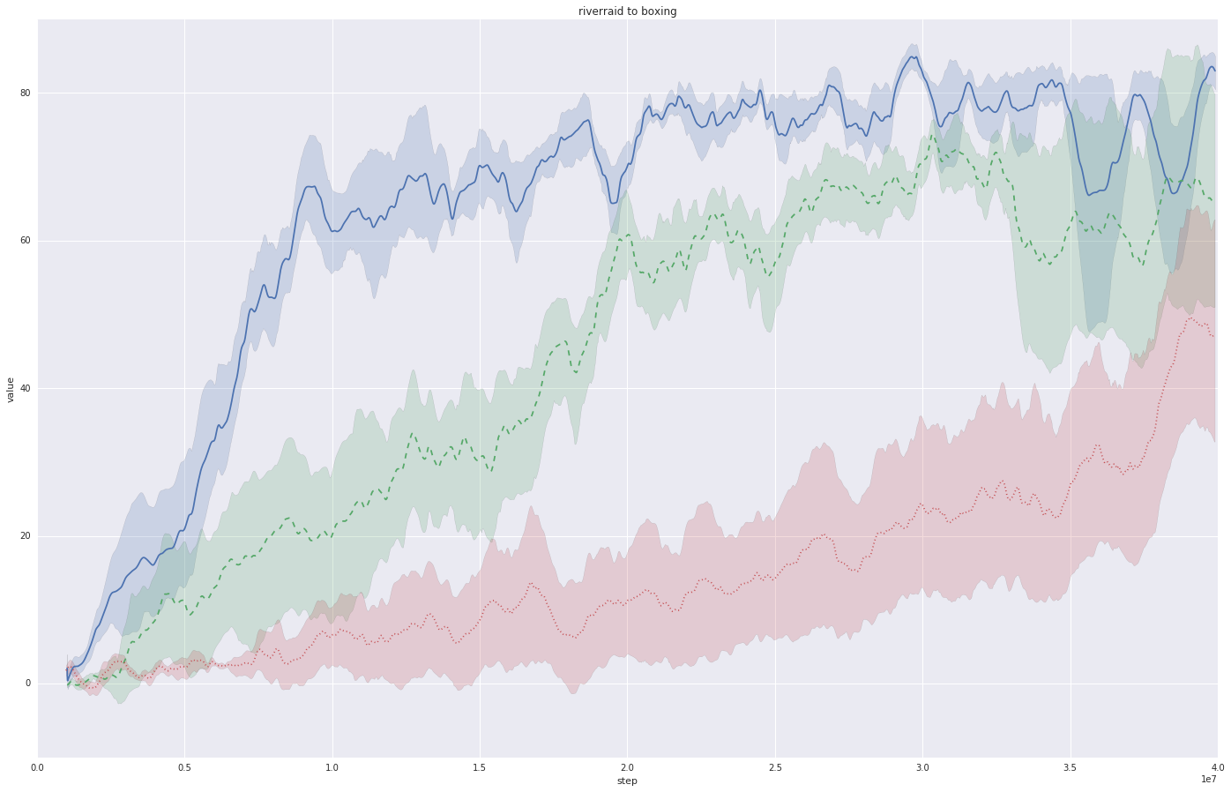
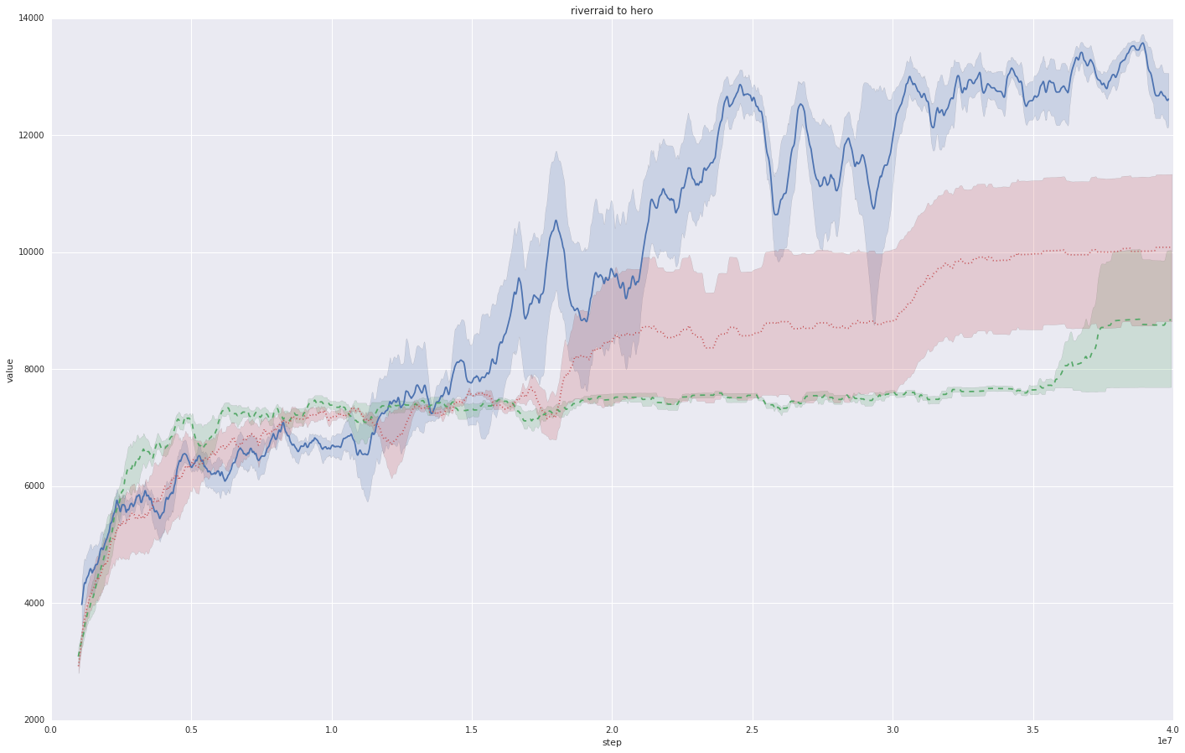
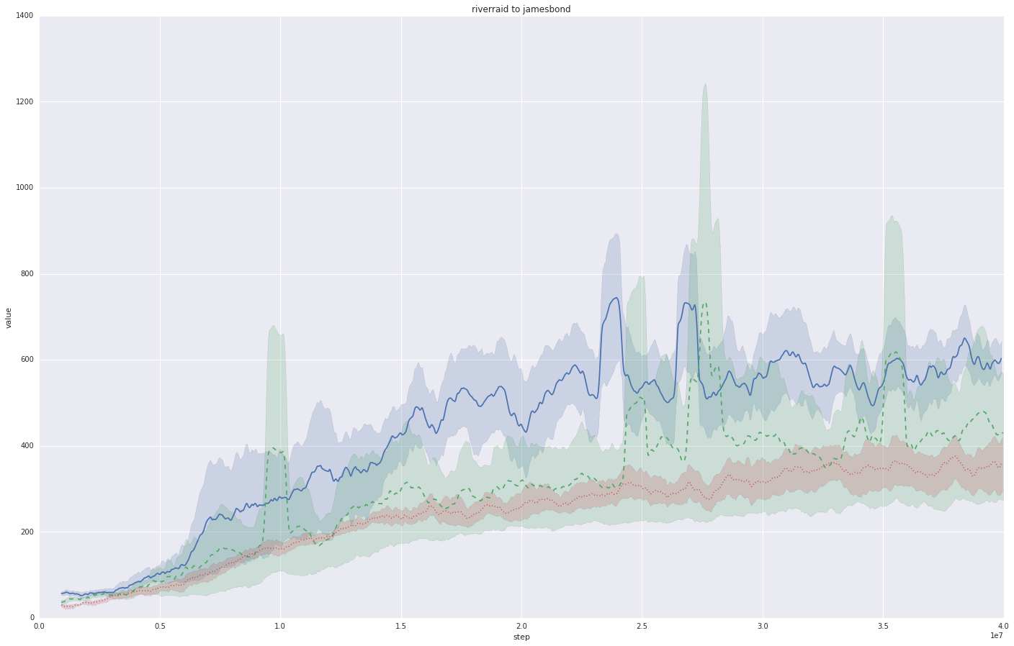
Centipede
Boxing
80
12
pathNet = Blue
60
10
Reward
Reward (x 10³)
40
8
Source Task: RiverRaid
Returns on the Target Task to 40M timesteps
Best five
(from a hyper- parameter sweep)
Fine Tuning = Green
6
20
4
20
Independent = Red
2
10
20
30
40
0
10
20
30
40
0
0
Steps (x 10⁶)
Steps (x 10⁶)
Hero
James Bond
12
12
10
10
Reward (x 10²)
Reward (x 10³)
8
8
6
6
4
4
2
2
10
20
30
40
0
10
20
30
40
0
Steps (x 10⁶)
Steps (x 10⁶)

Slide 31
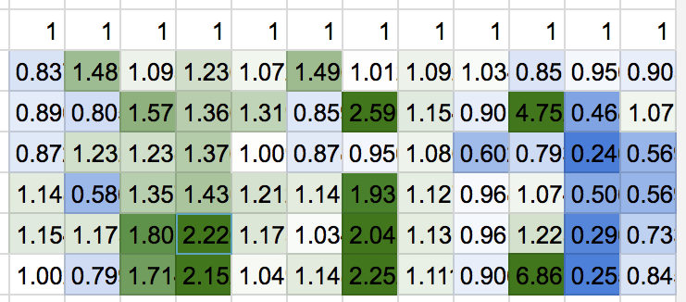
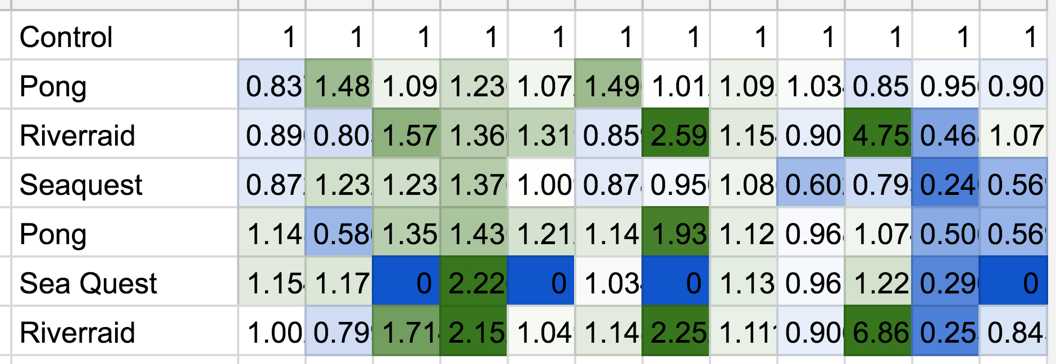
Atari Transfer Performance Improvement
Alien
Asterix
Boxing
Centipede
Gopher
Hero
JamesBond
Krull
Road_Runner
Robotank
Star_gunner
wizard_of_wor
Target task (2)
Source task (1)
Fine-tuning (mean 1.16)
Pathnet (mean 1.33)

Slide 32
Supervised Tasks

Slide 33
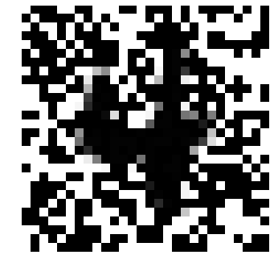
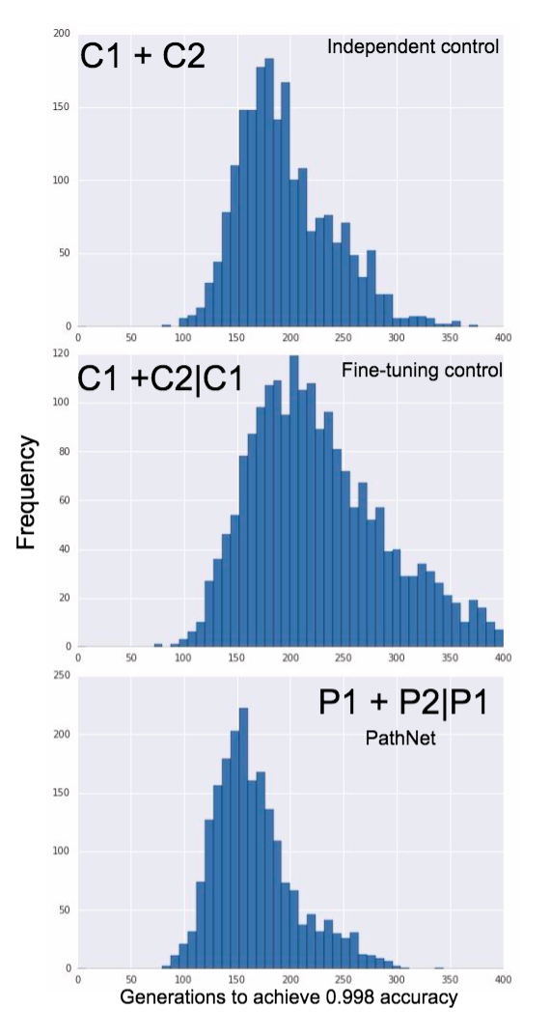
Binary MNIST Classification task
Tasks: 4v9 → 5v6
Both hard tasks
Blue square = current path
Size of red = fitness contribution
Green = converged path task 1.
Skip (identity), Linear, Residual modules present in each layer

Slide 34
Sequential vs Simultaneous Training
Sequential: LR = 0.001, MR = 0.05,
Pop = 10, Max Dag width = 3
Simultaneous : LR = 0.001, MR = 0.05,
Pop = 10, Max Dag width = 3

Slide 35
Conclusions

Slide 36
Conclusions
PathNet learns faster than de novo and fine-tuning controls over multiple transfer learning tasks.
When modules differ in properties, e.g. skip, residual, layer size, conv net hyperparameters, then pathnet executes embedded architecture search.
An obvious extension is to make the pathway conditional on the observation so that the path being executed can change throughout the task, but this poses special challenges.

Slide 37
Thanks

